Slide 1
SmartKYC User flow

Slide 2
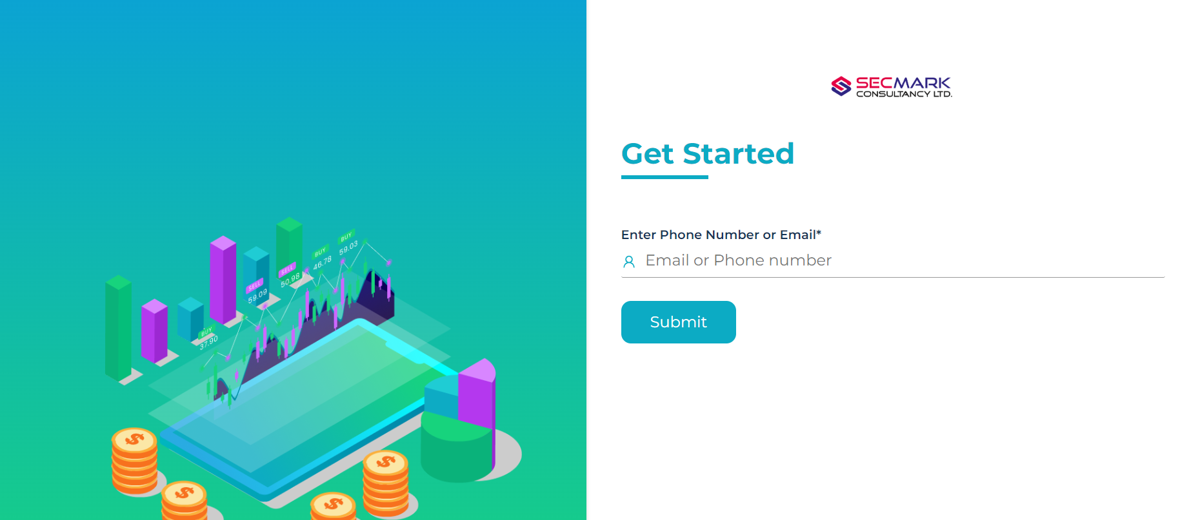
1. User can sign up for SmartKYC using your mobile number or email ID.

Slide 3
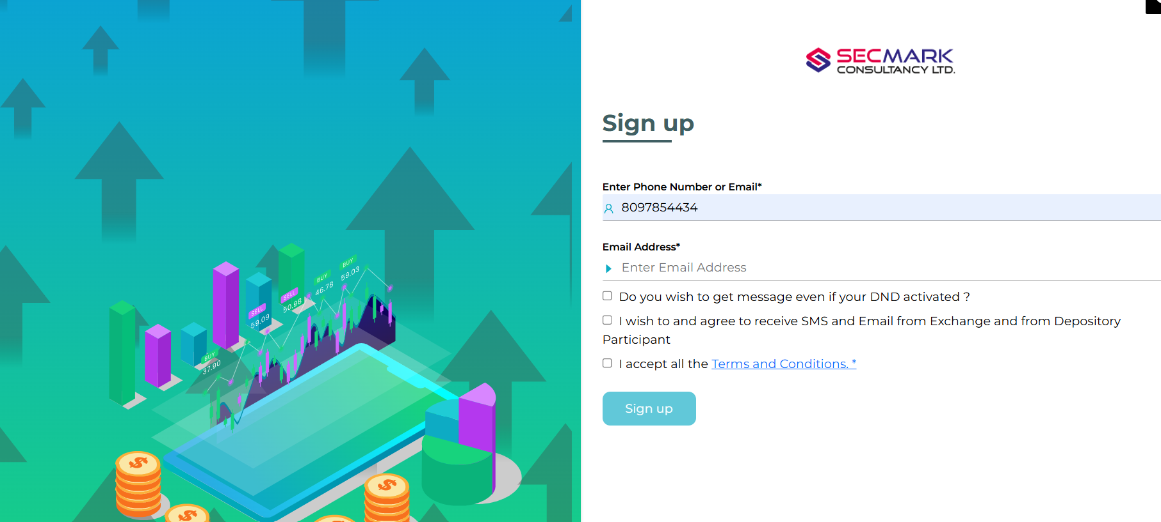
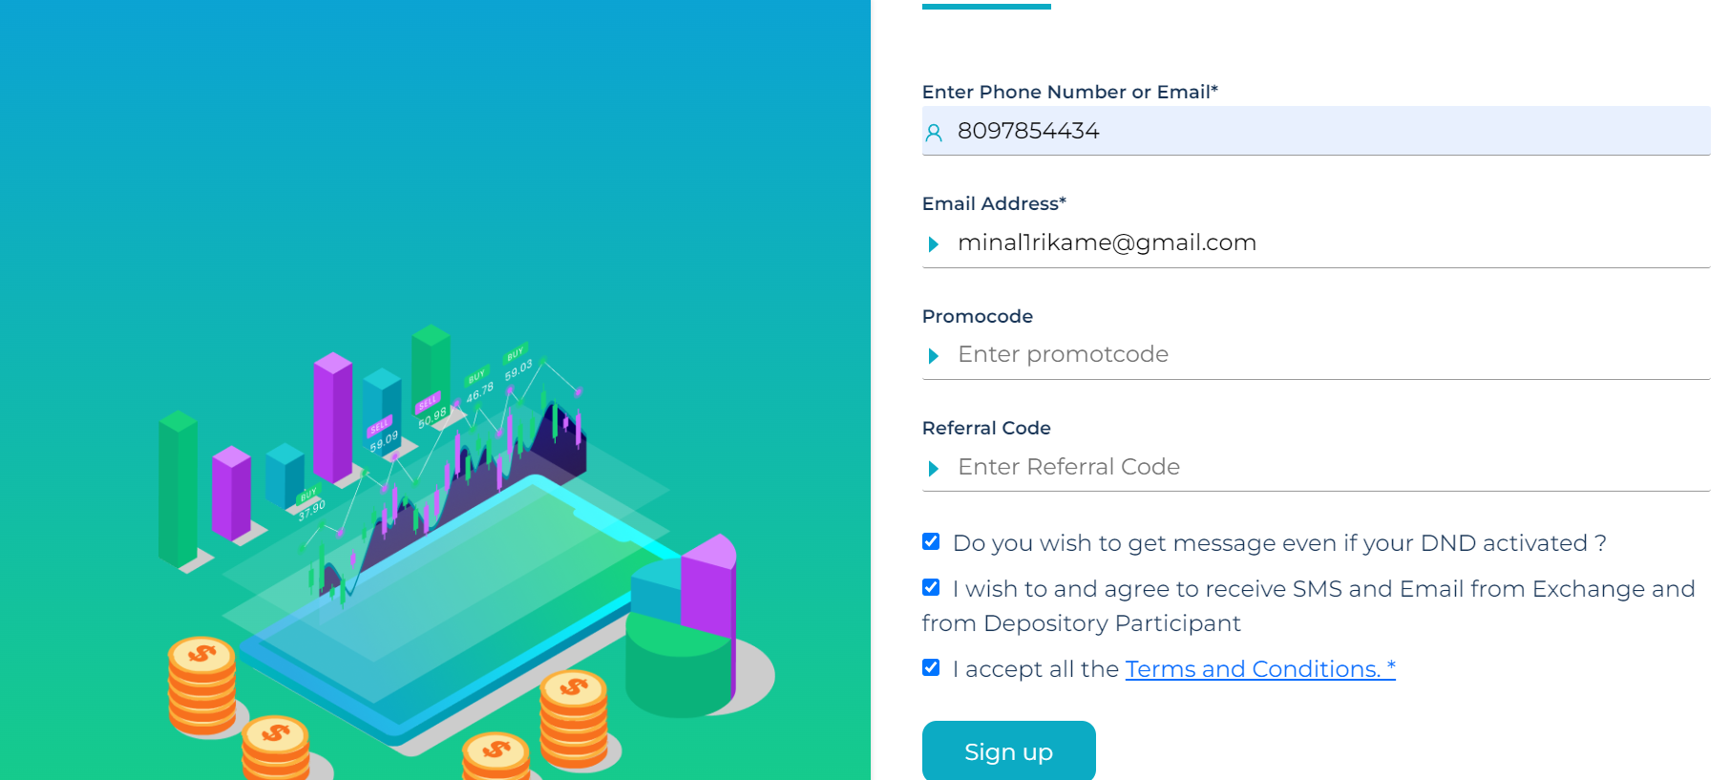
2. After entering your mobile number or email ID, you will be prompted to provide the required details. Select the mandatory checks as applicable and proceed to submit the information.

Slide 4
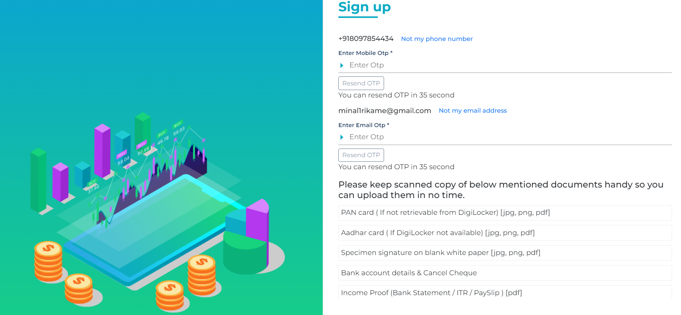
3. Enter the One-Time Password (OTP) received on your registered mobile number or email ID to proceed with the verification process.

Slide 5
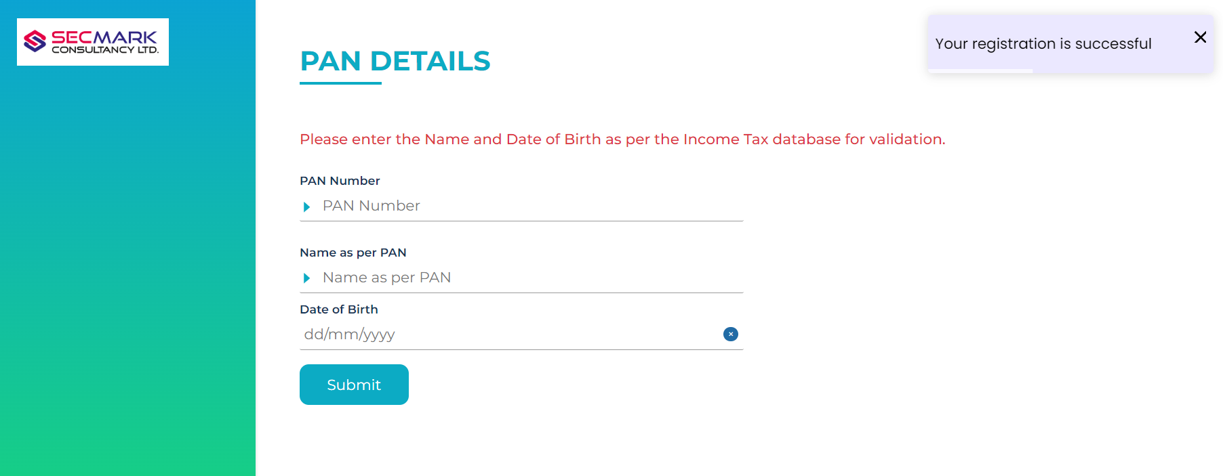
4. You will be redirected to the PAN Verification page. Enter your PAN number, your name as per PAN records, and your date of birth, then proceed to submit the details.

Slide 6
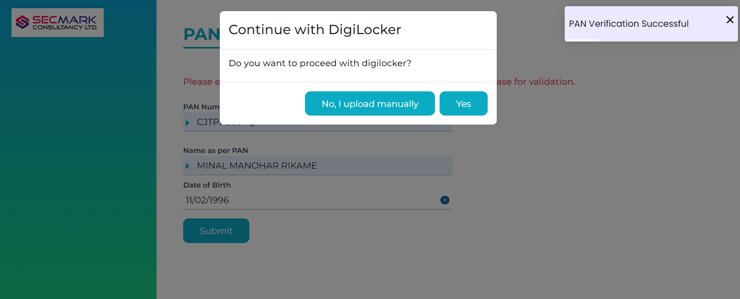
5. After submitting your details, you will be prompted to choose whether you want to upload the required documents manually or proceed through the DigiLocker verification process.

Slide 7
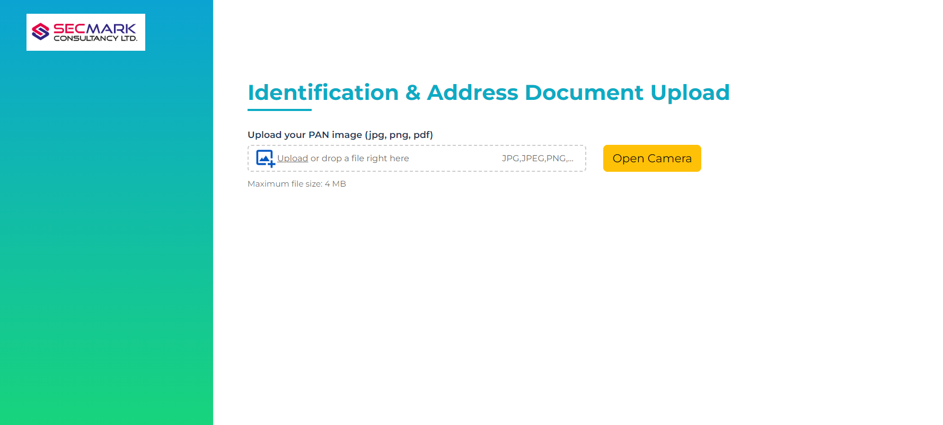
6. If you choose to upload documents manually, you will be redirected to the PAN Upload page, where you must upload a clear and valid copy of your PAN card.

Slide 8
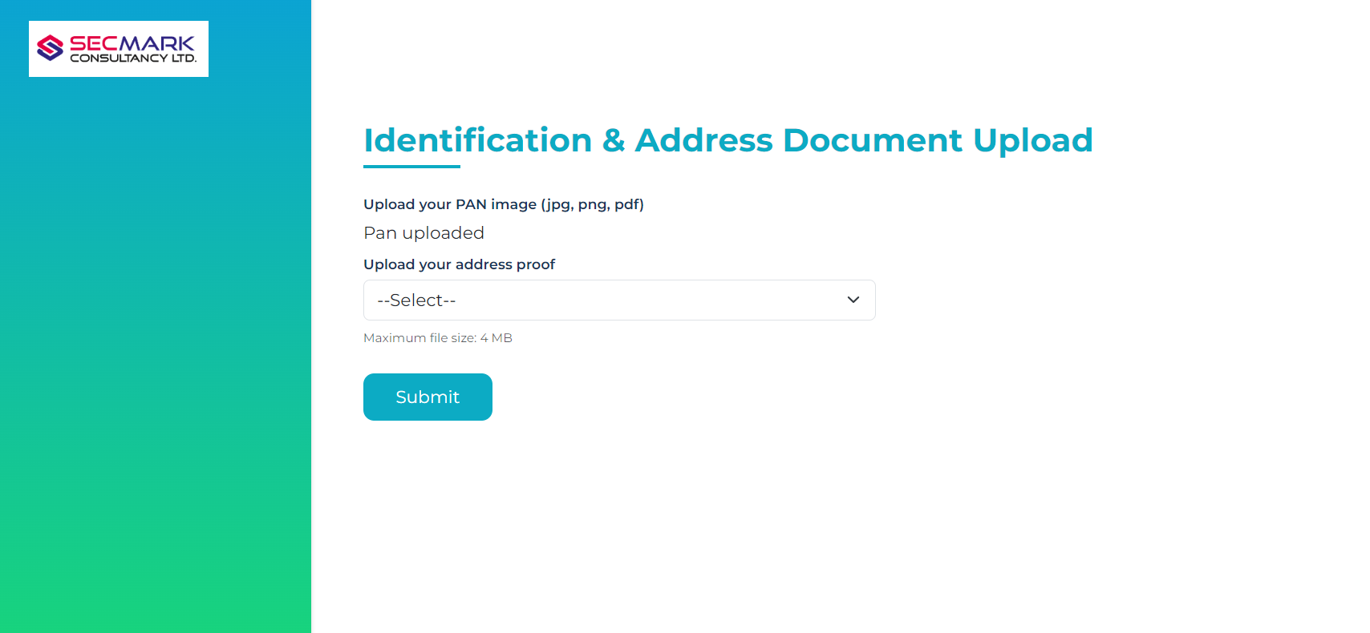
7. Next you will be required to upload your address proof—front and back images of Aadhaar card, Voter ID, Driving License, or Passport.

Slide 9
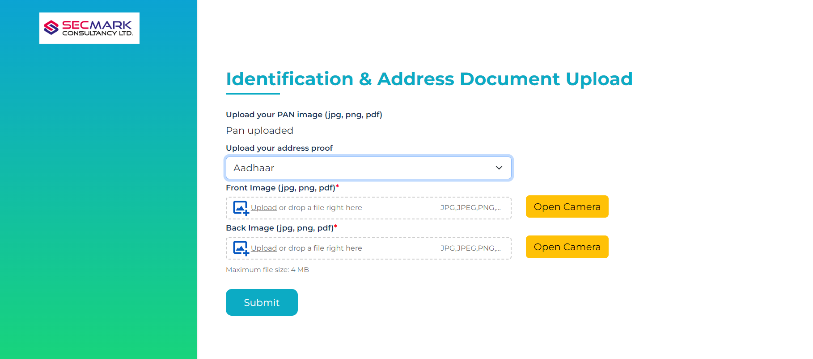
8. If you upload an Aadhaar Card, both front and back images are mandatory. The Aadhaar number (UID) will be masked automatically, and details will be extracted using OCR.

Slide 10
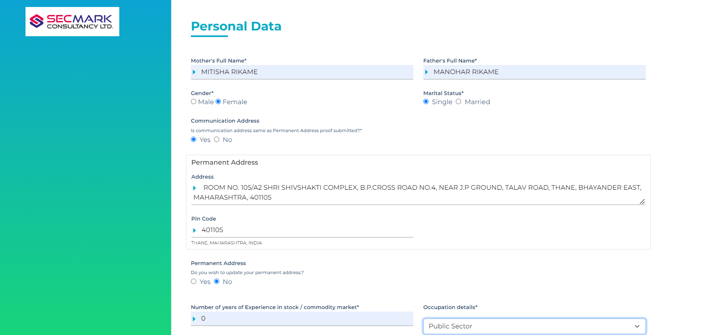
9. In the Personal Details section, enter your personal information and answer the mandatory questions related to account opening.

Slide 11
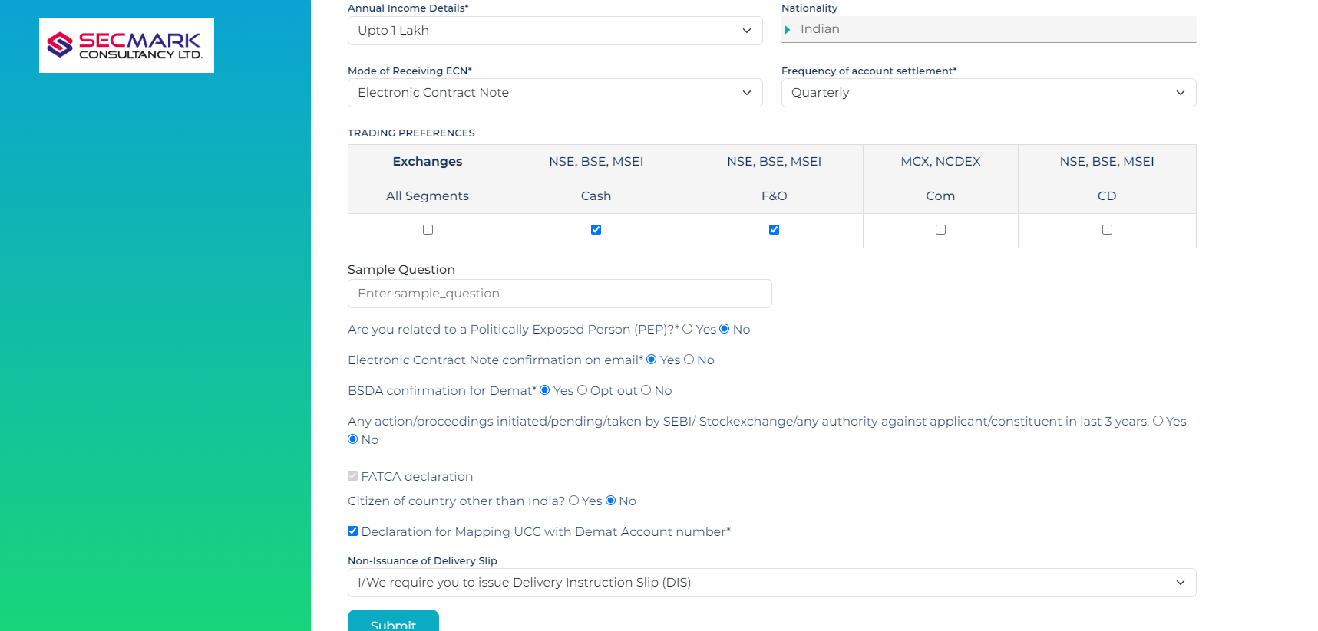
10. Also select the segments you wish to select

Slide 12
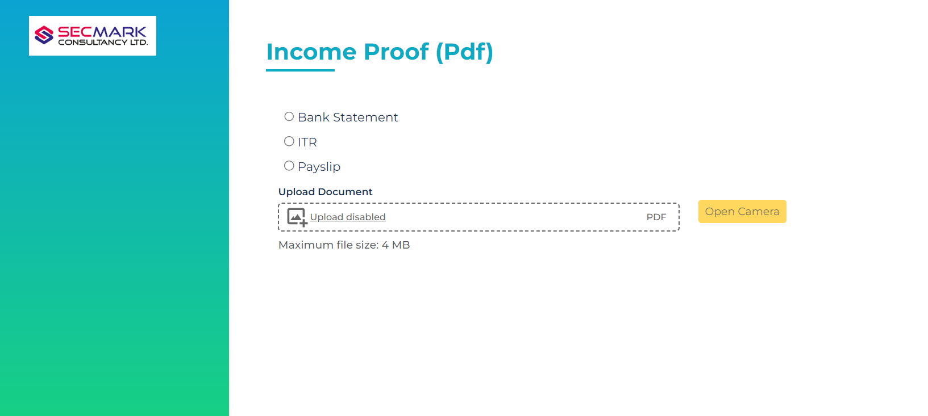
11. If you choose CM or F&O, you need to upload income proof, such as a bank statement, ITR, or payslip.

Slide 13

12. Next, user can add a nominee.

Slide 14
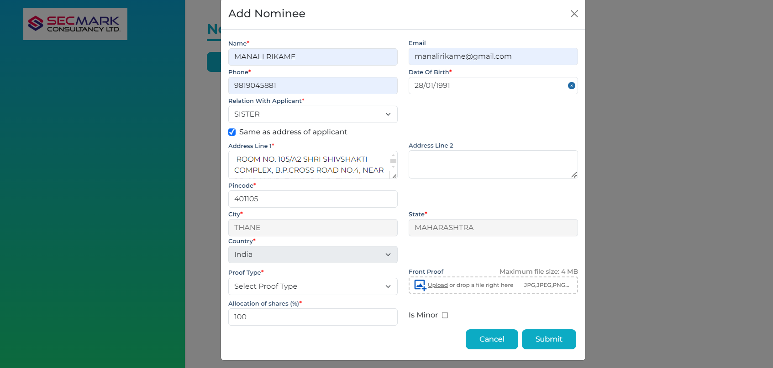
13. You must fill in all the details for the nominee and provide one valid document

Slide 15
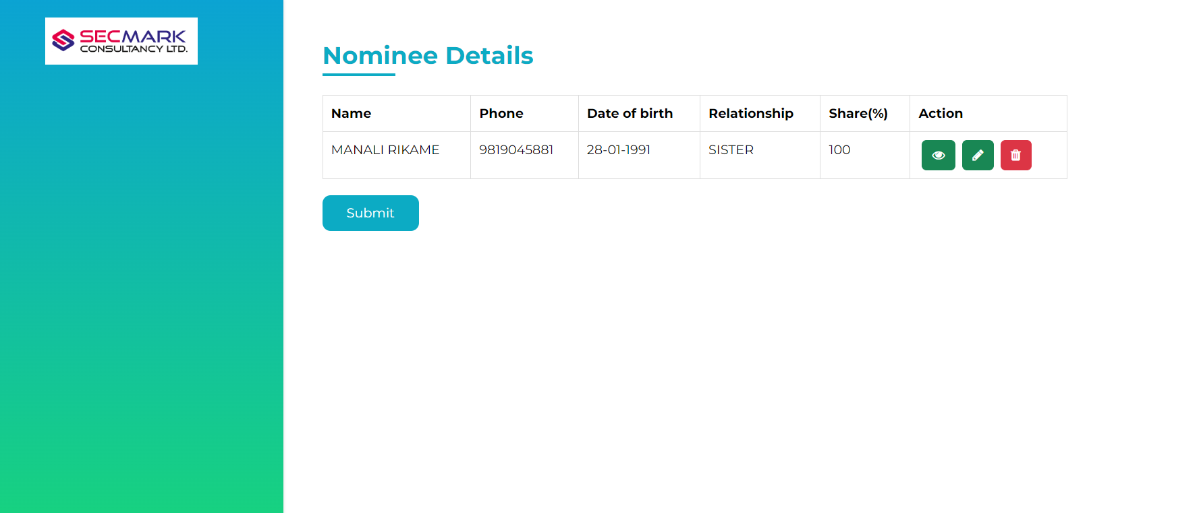
14. You can view, edit & delete the nominee details by clicking icons

Slide 16
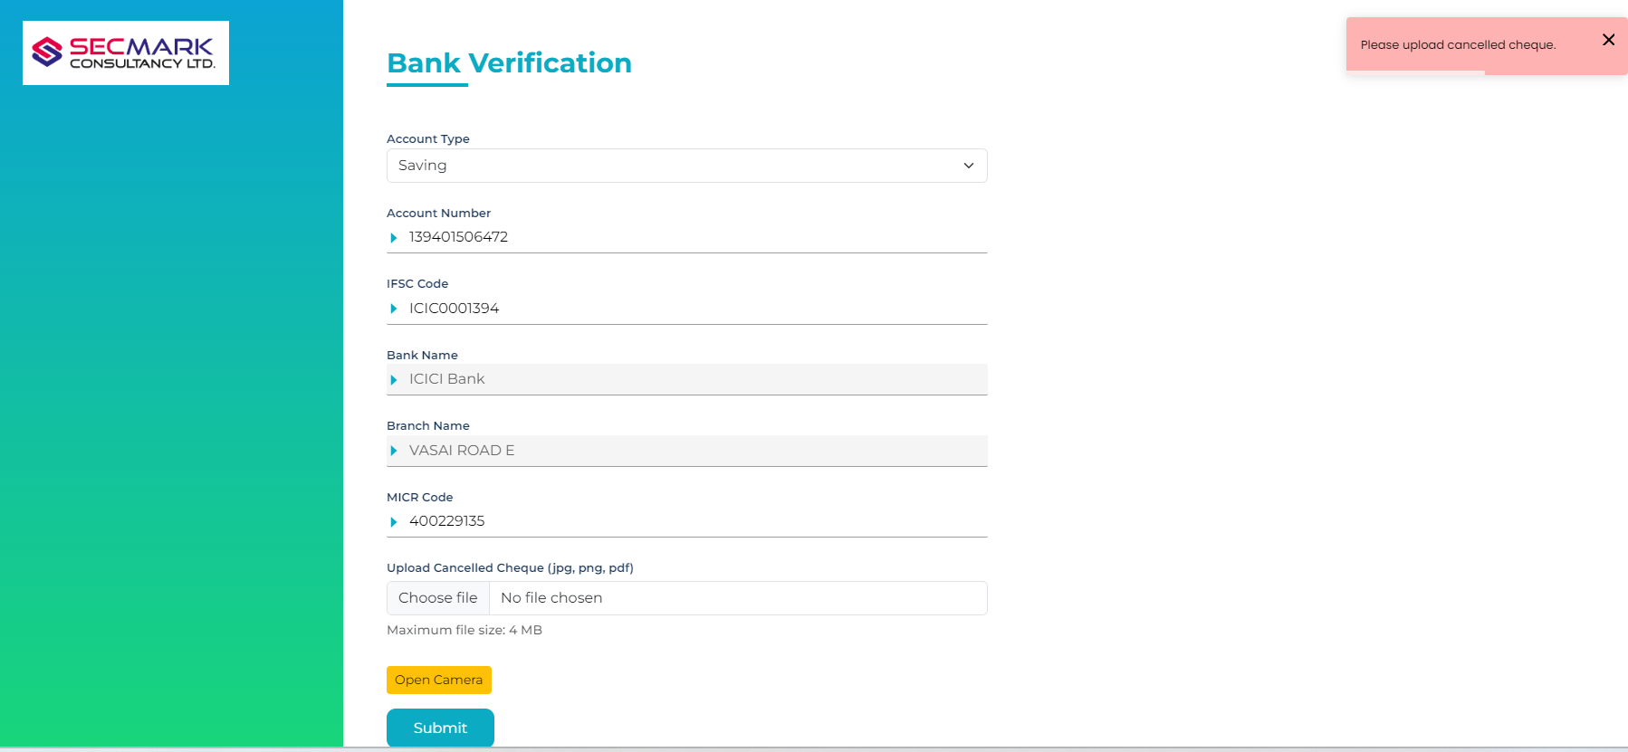
15. Add your bank details, including your account number and IFSC code. The account will be verified through a penny drop process; otherwise, upload your bank documents

Slide 17
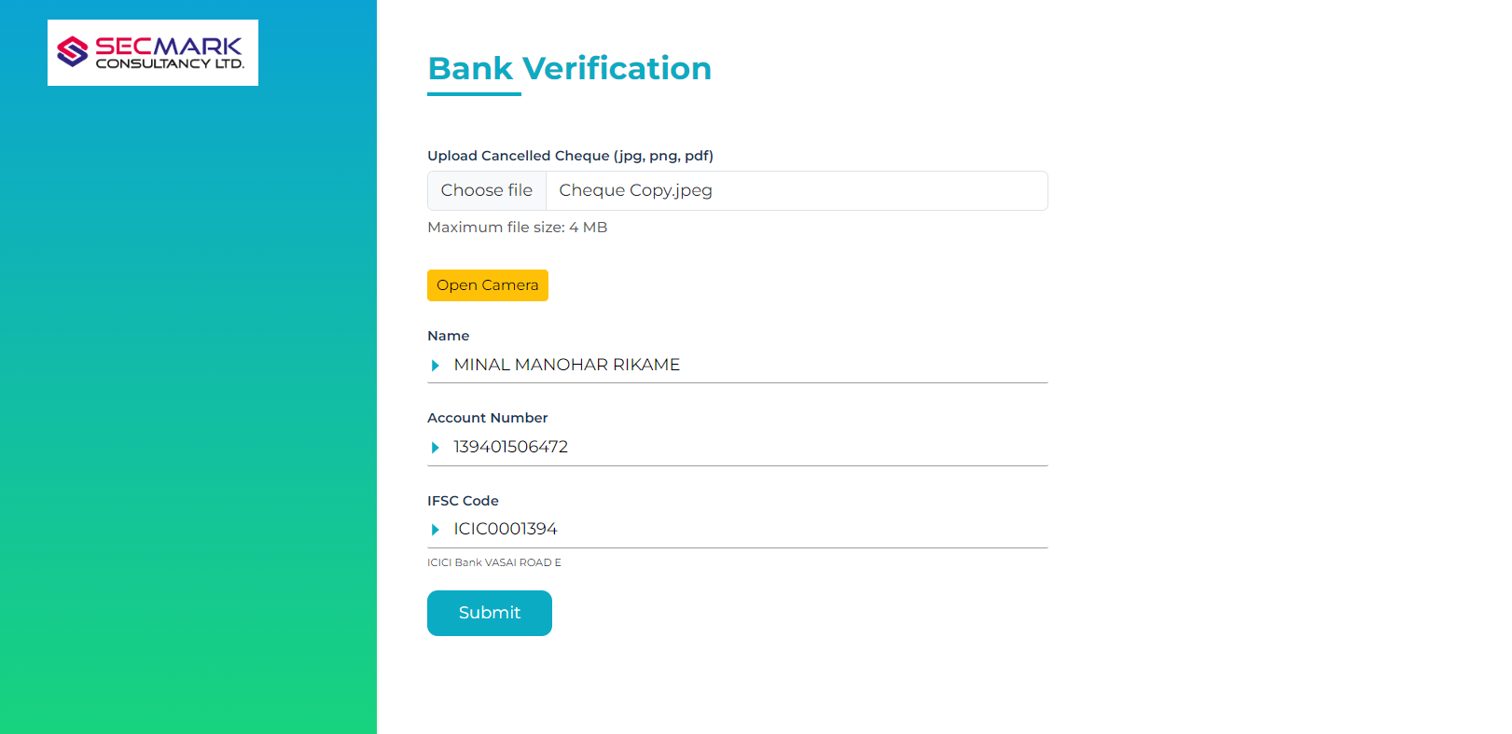
16. If penny drop fails upload cheque copy for OCR

Slide 18
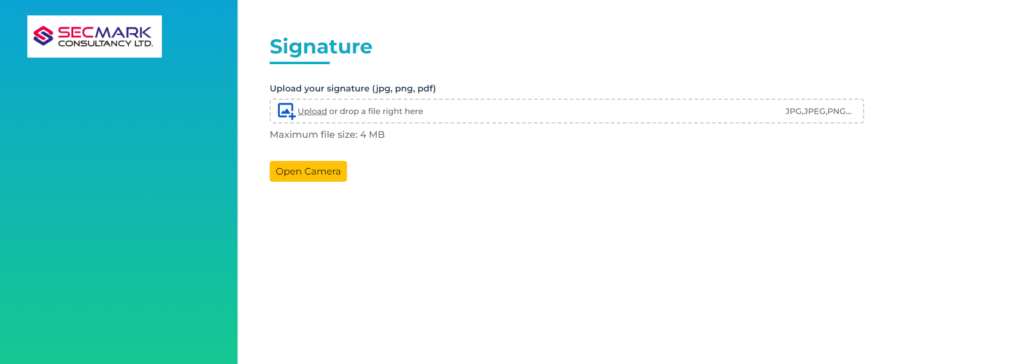
17.Upload your signature on a blank page.

Slide 19
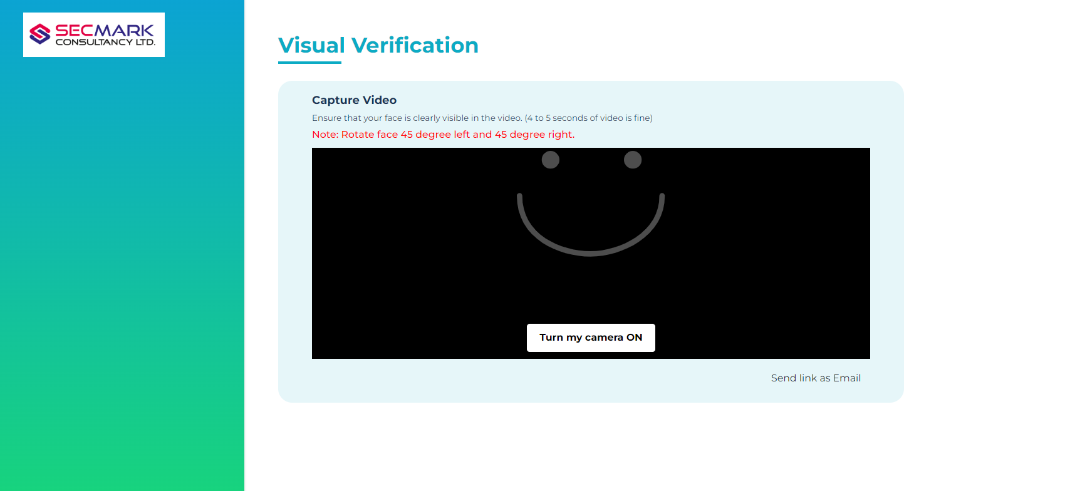
18. Record a clear 5–7 second video for the live photo.

Slide 20
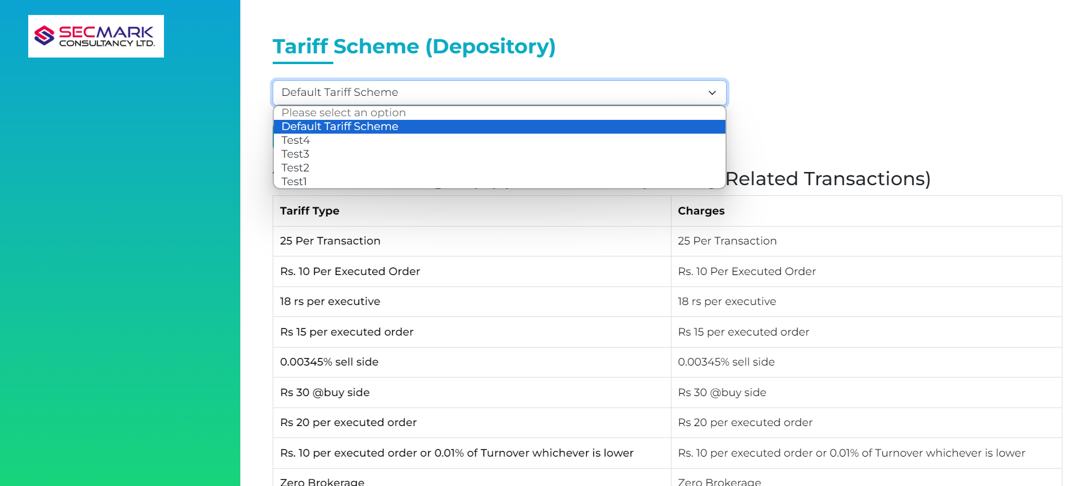
19. Add a tariff scheme from the options given below.

Slide 21
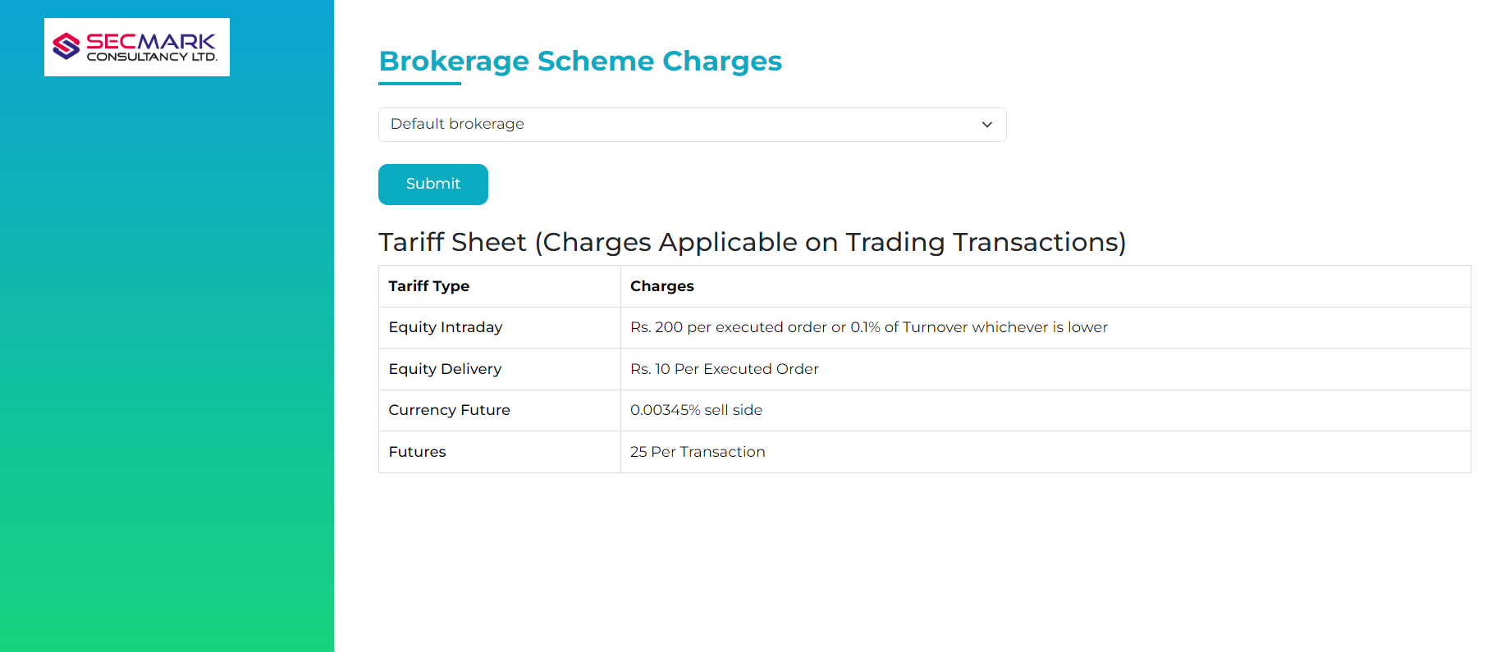
20. Select the brokerage sheet user want

Slide 22
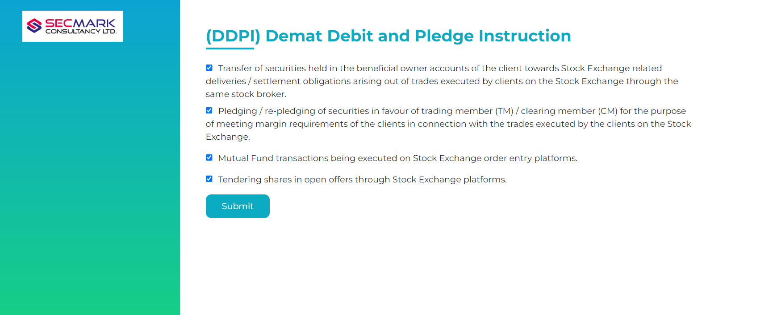
21. Select the options for DDPI

Slide 23
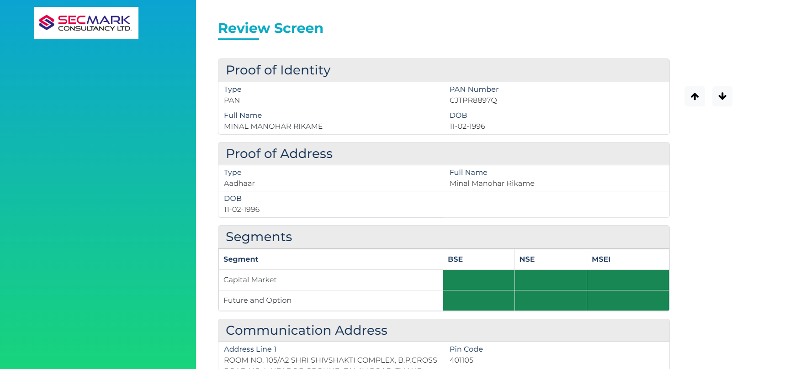
22. Review all the details you have filled in.

Slide 24
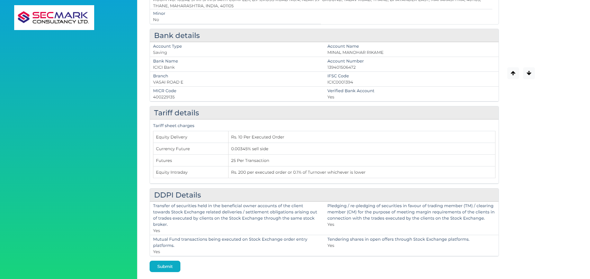
23. Submit the form after reviewing it.

Slide 25
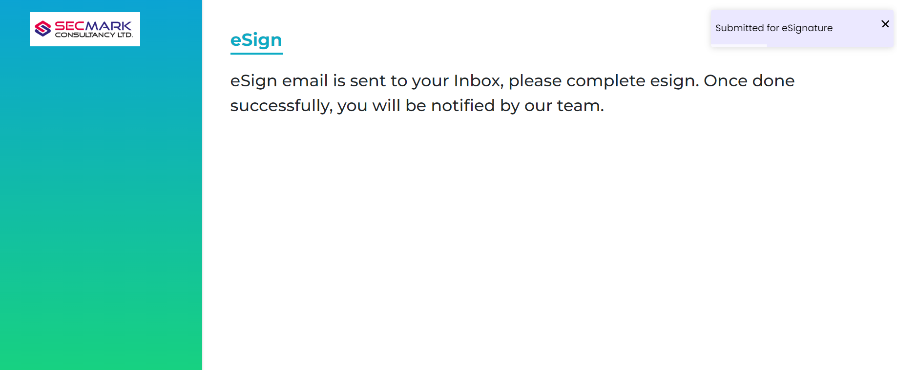
24. You will receive an email containing the unsigned form and two forms for e-signature: KRA and KYC.

